Slide 1



GRATEFUL DISCIPLES
WIFI: STJOffice Password: Matthew25

Slide 2

LET US PRAY
Holy Spirit, Fire of Love,
Open our hearts and minds to the blessings
of life, faith, and resources.
Come, Holy Spirit!
Guide us as we walk the ways of discipleship.
Come, Holy Spirit!
Make us faithful stewards of all we are, have, and will be.
Come, Holy Spirit!
2
© Ctholic Life and Faith, 2017

Slide 3
Give us courage to serve boldly and with compassion.
Come, Holy Spirit!
Strengthen our faith as we grow more deeply in relationship
with Christ and one another.
Come, Holy Spirit!
Enliven us in your presence.
Come, Holy Spirit!
For you are God with the Father and the Son,
now and forever.
Come, Holy Spirit, Come! Amen.
3
© Catholic Life and Faith, 2017

Slide 4

LET’S FOCUS
Your role?
Your experience?
4
© Catholic Life and Faith, 2017

Slide 5
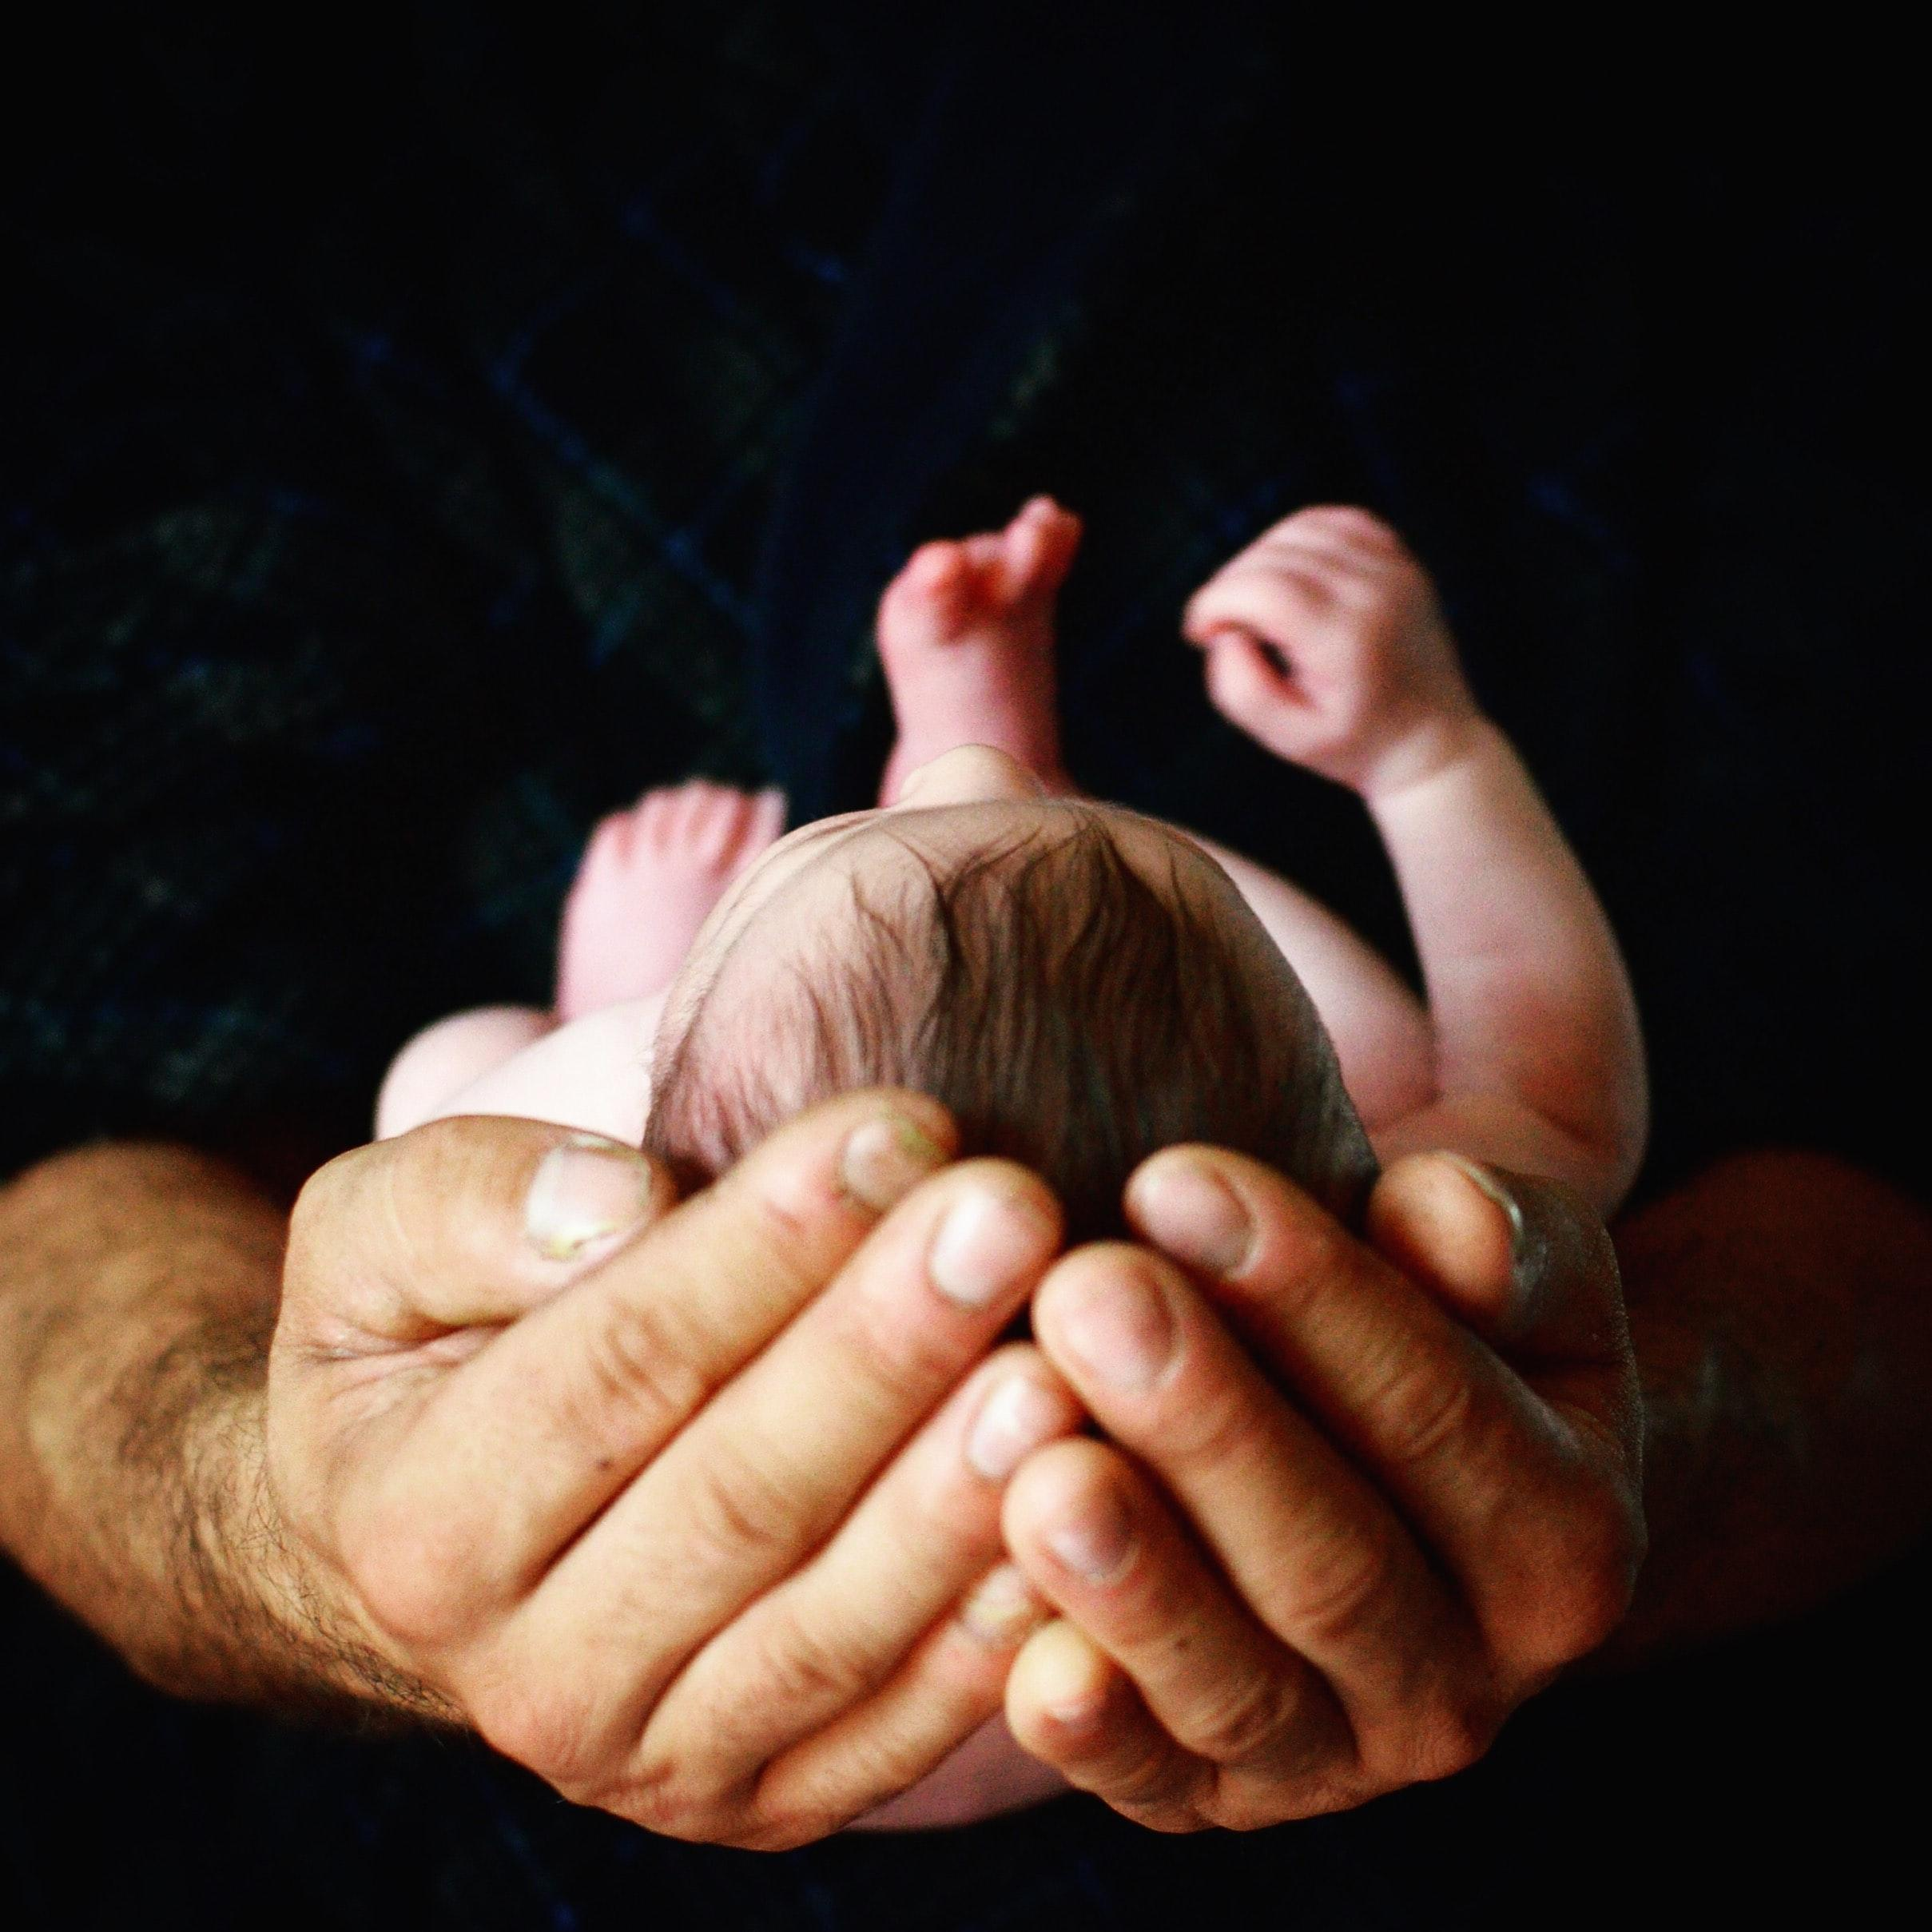
Created in God's Image,
Called to Holiness

Slide 6

Humans in the image and likeness of God
“The transparency through which God is seen.”
Collaborators with God in the continuing task of creation
6
© Catholic Life and Faith, 2017

Slide 7

All is blessing!
“God looked at everything he had made and found it very good.”
— Genesis 1:31

Slide 8
All is blessing!
Entrusted to us
Called to steward well
Grow in gratitude
“God looked at everything he had made and found it very good.”
— Genesis 1:31

Slide 9
…Beginning in conversion, change of mind and heart, this commitment is expressed not in a single action, nor even in a number of actions over a period of time,
but in an entire way of life.
It means committing one’s very self to the Lord.
(SDR, Introduction)…
“God looked at everything he had made and found it very good.”
— Genesis 1:31

Slide 10
…Stewardship is an expression of discipleship with the power to change how we understand and live out our lives.
(SDR, Introduction)
“God looked at everything he had made and found it very good.”
— Genesis 1:31

Slide 11
LET’S FOCUS
What gifts or blessings have been
entrusted to you?
In what ways do you steward these well?
11
© Catholic Life and Faith, 2017

Slide 12
Stewards in Community
12
© Catholic Life and Faith, 2017

Slide 13
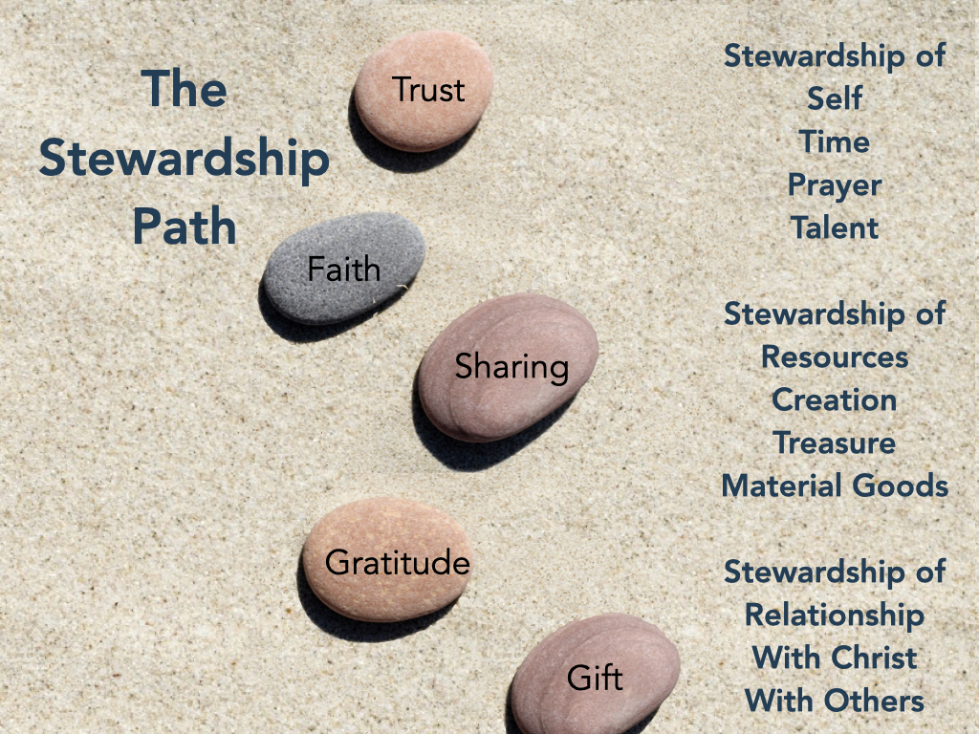

Get on the path
Individually
Communally
Ministerially
13

Slide 14

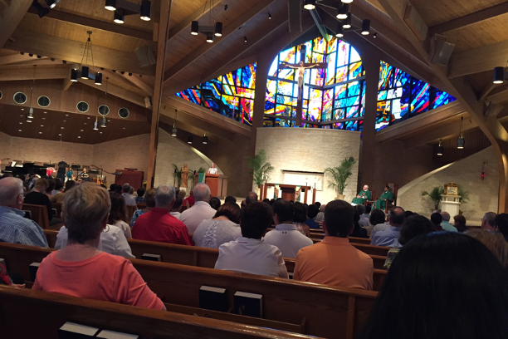
We do this best in community
Name…
Claim…
Aim…
14
© Catholic Life and Faith, 2017

Slide 15
Jesus is the supreme teacher of Christian stewardship as he is of every other aspect of Christian life; and in Jesus’ teaching and life
self-emptying is fundamental. – SDR 19

Slide 16
Through baptism, we are drawn into Christ’s Body
Into a life of discipleship
Into communion with Christ and one another

Slide 17
Growing as a Community of Stewards
Greater engagement
Increased involvement
Naturally evangelizing
Deeper spirituality
Willingness to be challenged
Joy!
17
© Catholic Life and Faith, 2017

Slide 18
LET’S FOCUS
What comes to mind for you?
Where is stewardship most needed in your Family of Parishes?
18
© Catholic Life and Faith, 2017

Slide 19
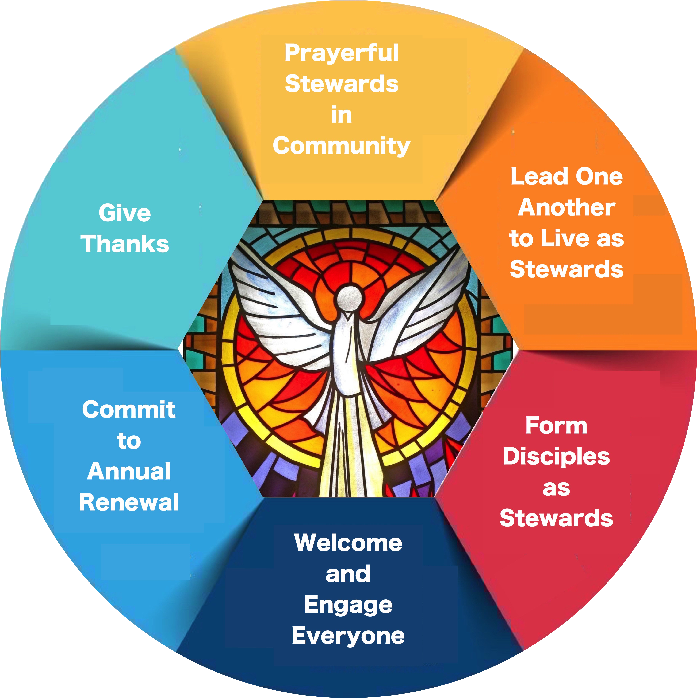
PART THREE:
The Grateful Disciples Process
19
© Catholic Life and Faith, 2017

Slide 20
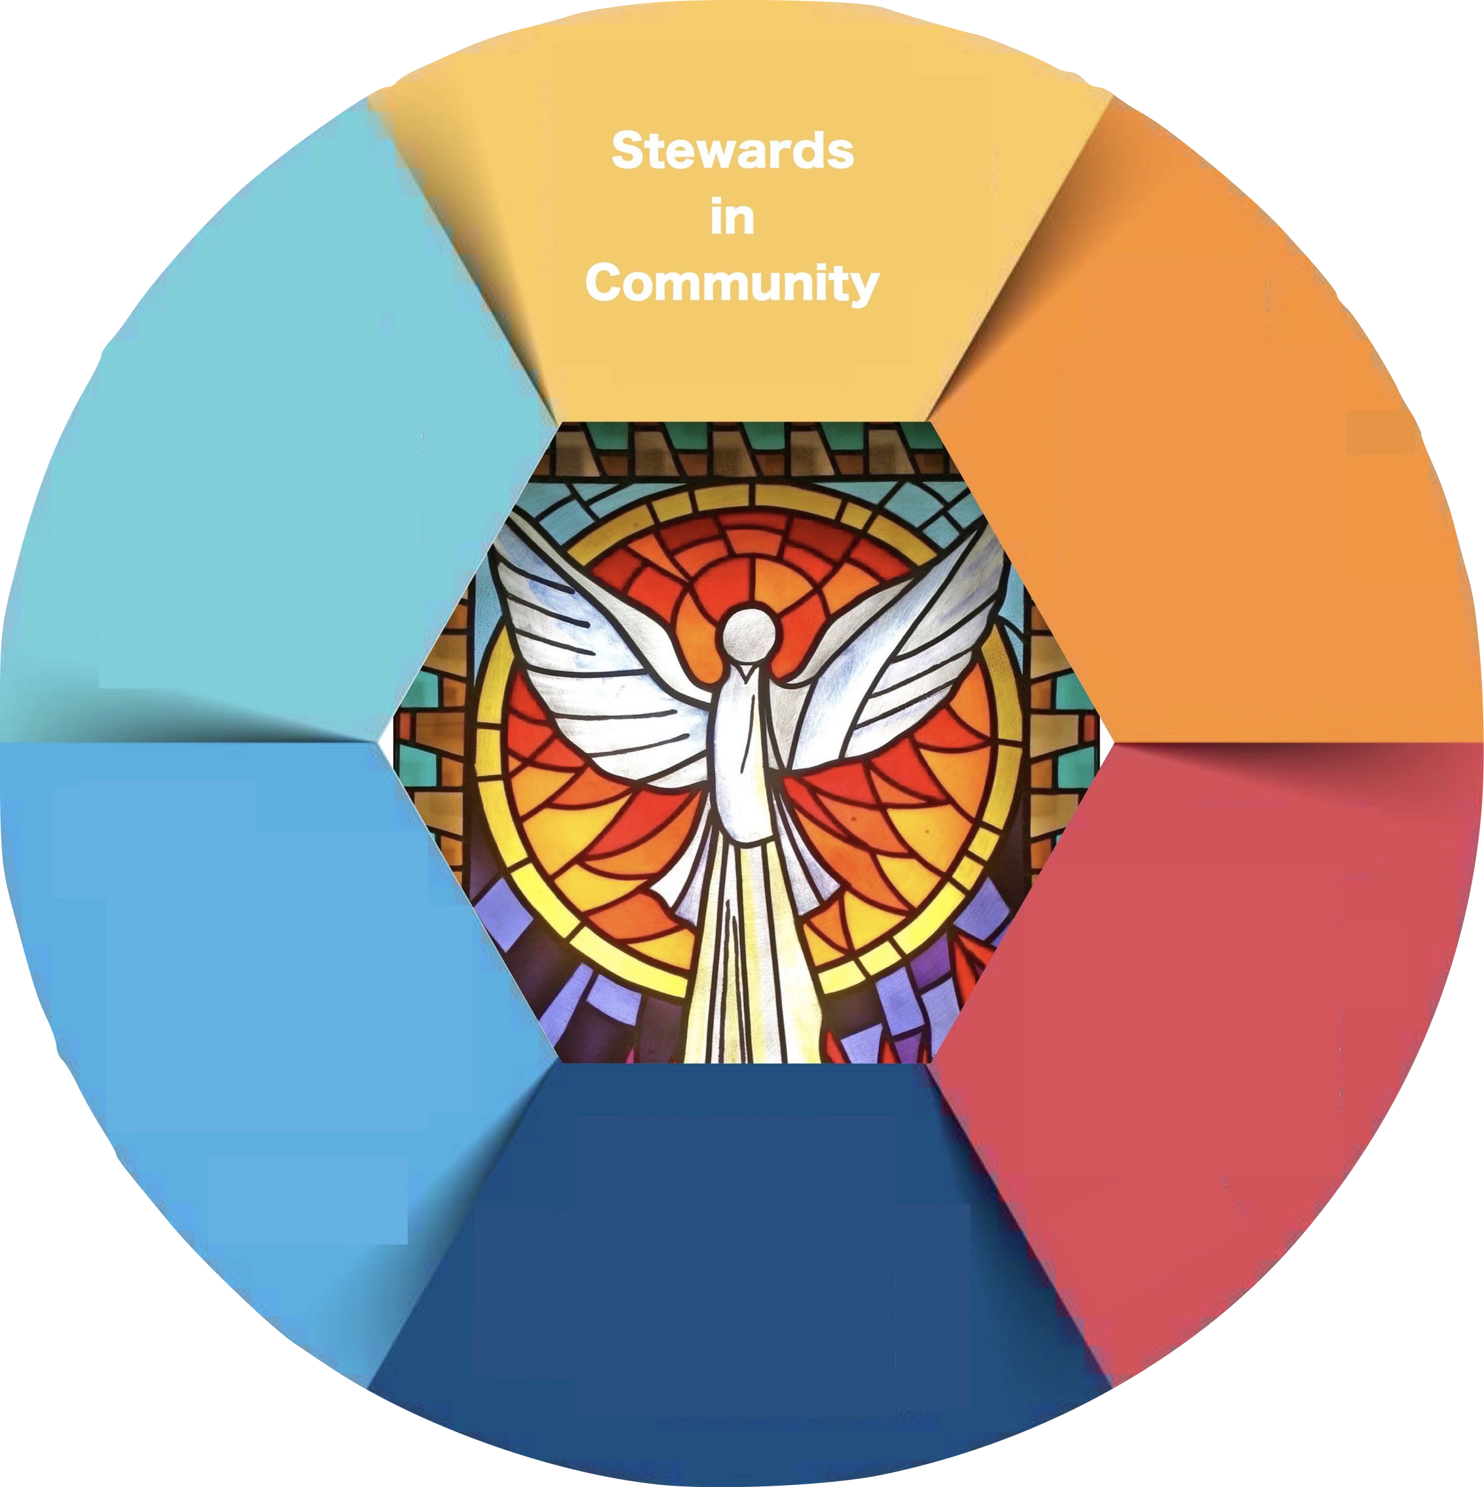
PART THREE:
Beacons of Light Connections
Stewardship Principle
Families of Parishes are communities of grateful disciples. Recognizing God’s gifts, they use their talents, skills and resources to build up the Church and live as Christ’s Body in the world.
20
© Catholic Life and Faith, 2017

Slide 21
PART THREE:
Beacons of Light Connections
Stewards in Community
Vision
Discipleship
Mission
21
© Catholic Life and Faith, 2017

Slide 22
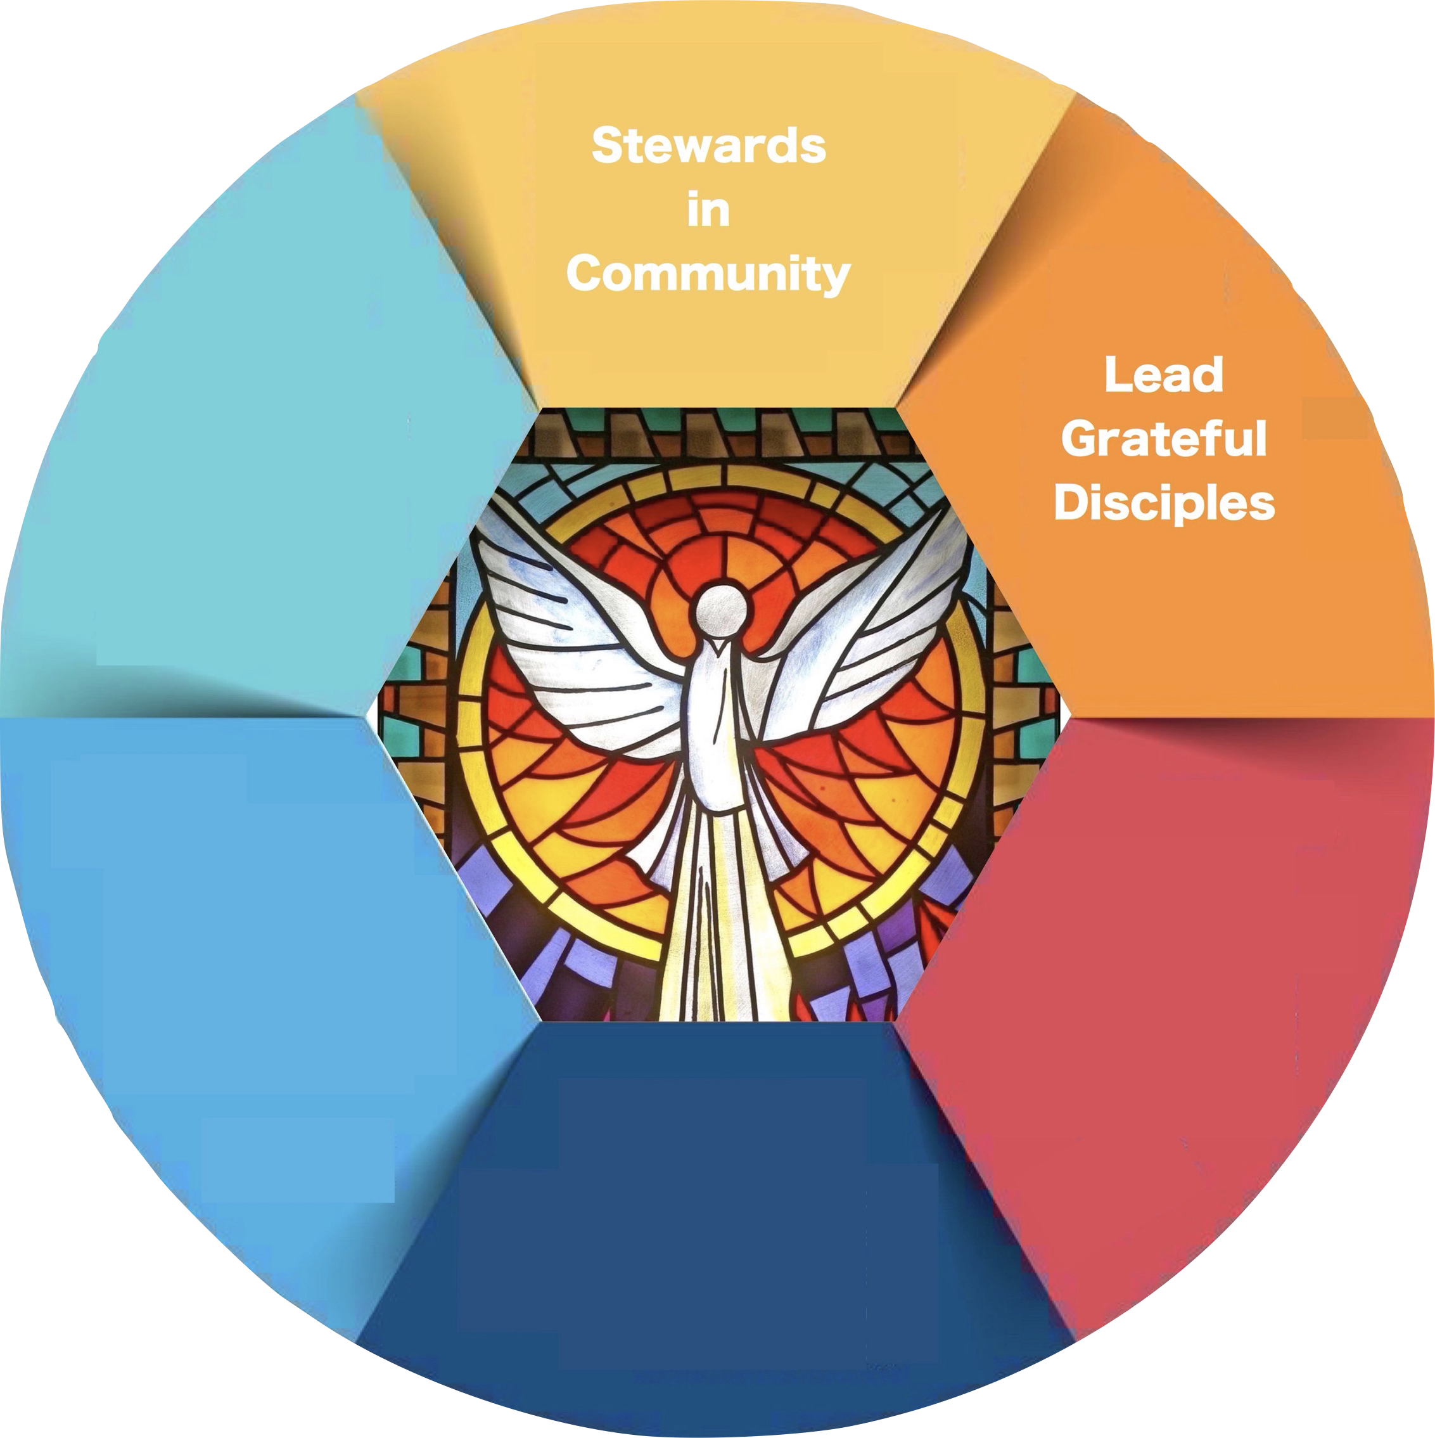
PART THREE:
Beacons of Light Connections
Leadership
Co-responsibility
Synodality
Active participation
22
© Catholic Life and Faith, 2017

Slide 23
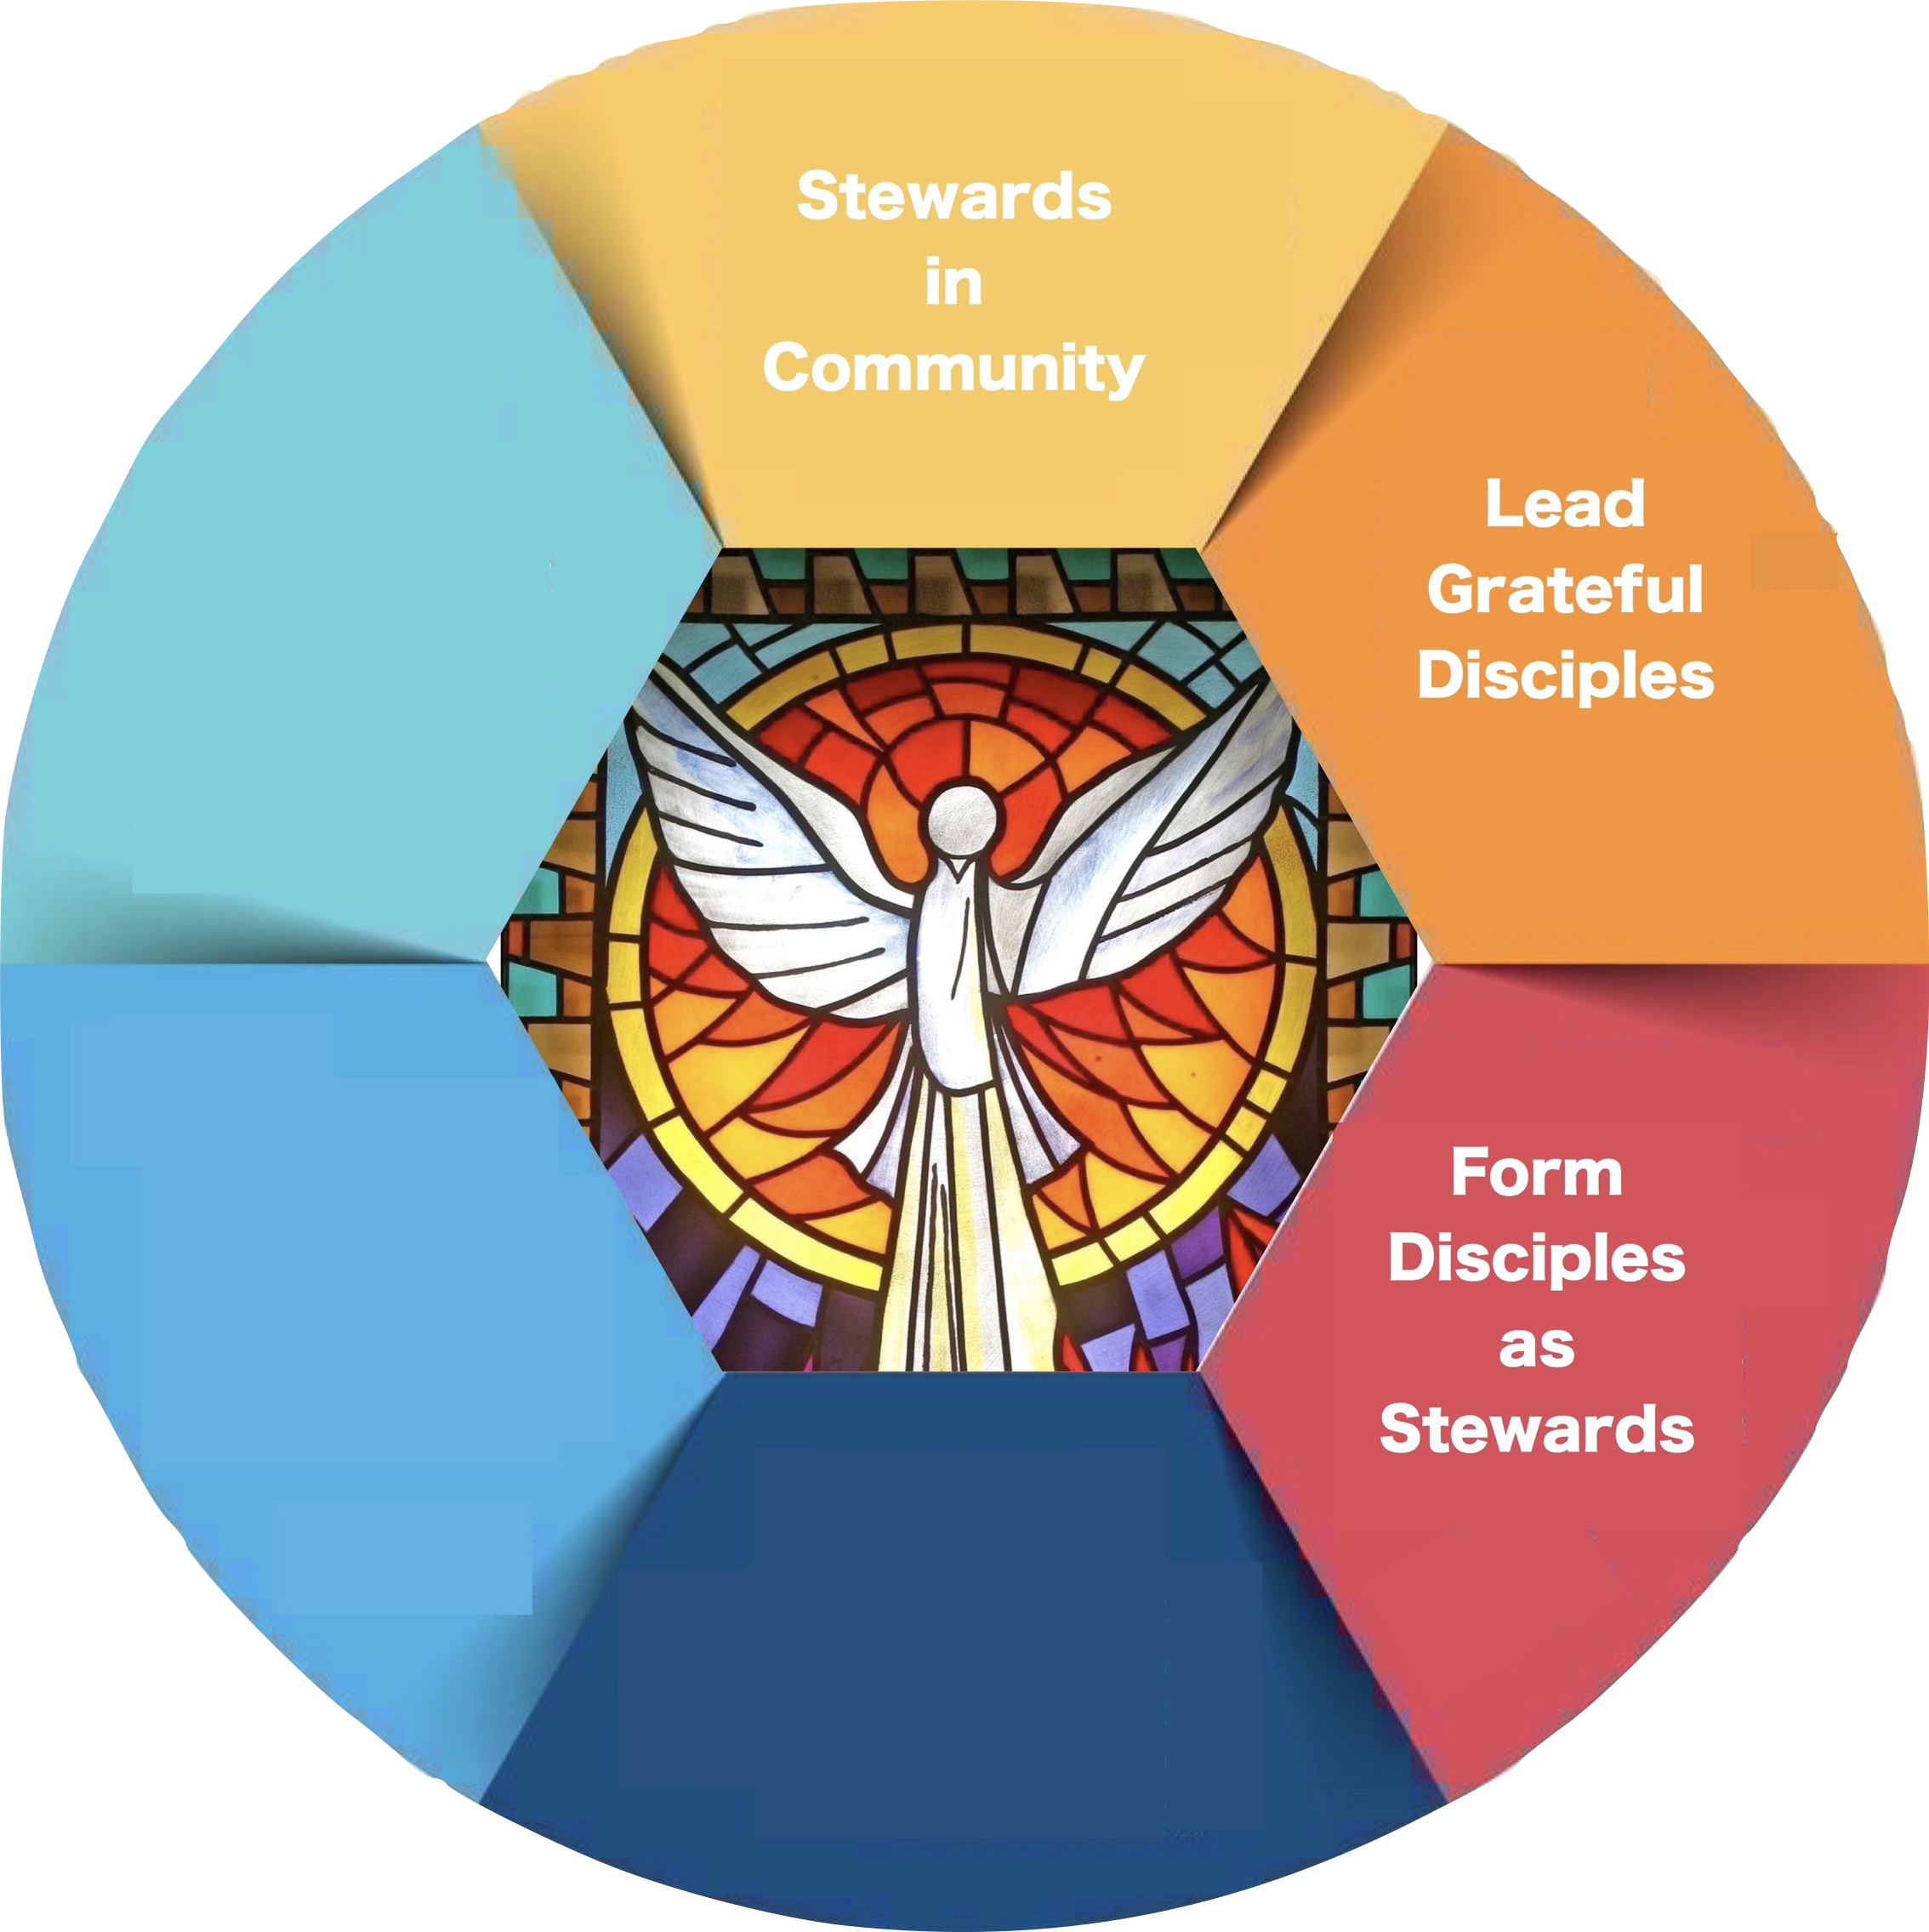
PART THREE:
Beacons of Light Connections
Form Disciples as Stewards
Missionary discipleship
Gifts, charisms, talents
Vocational discernment
23
© Catholic Life and Faith, 2017

Slide 24
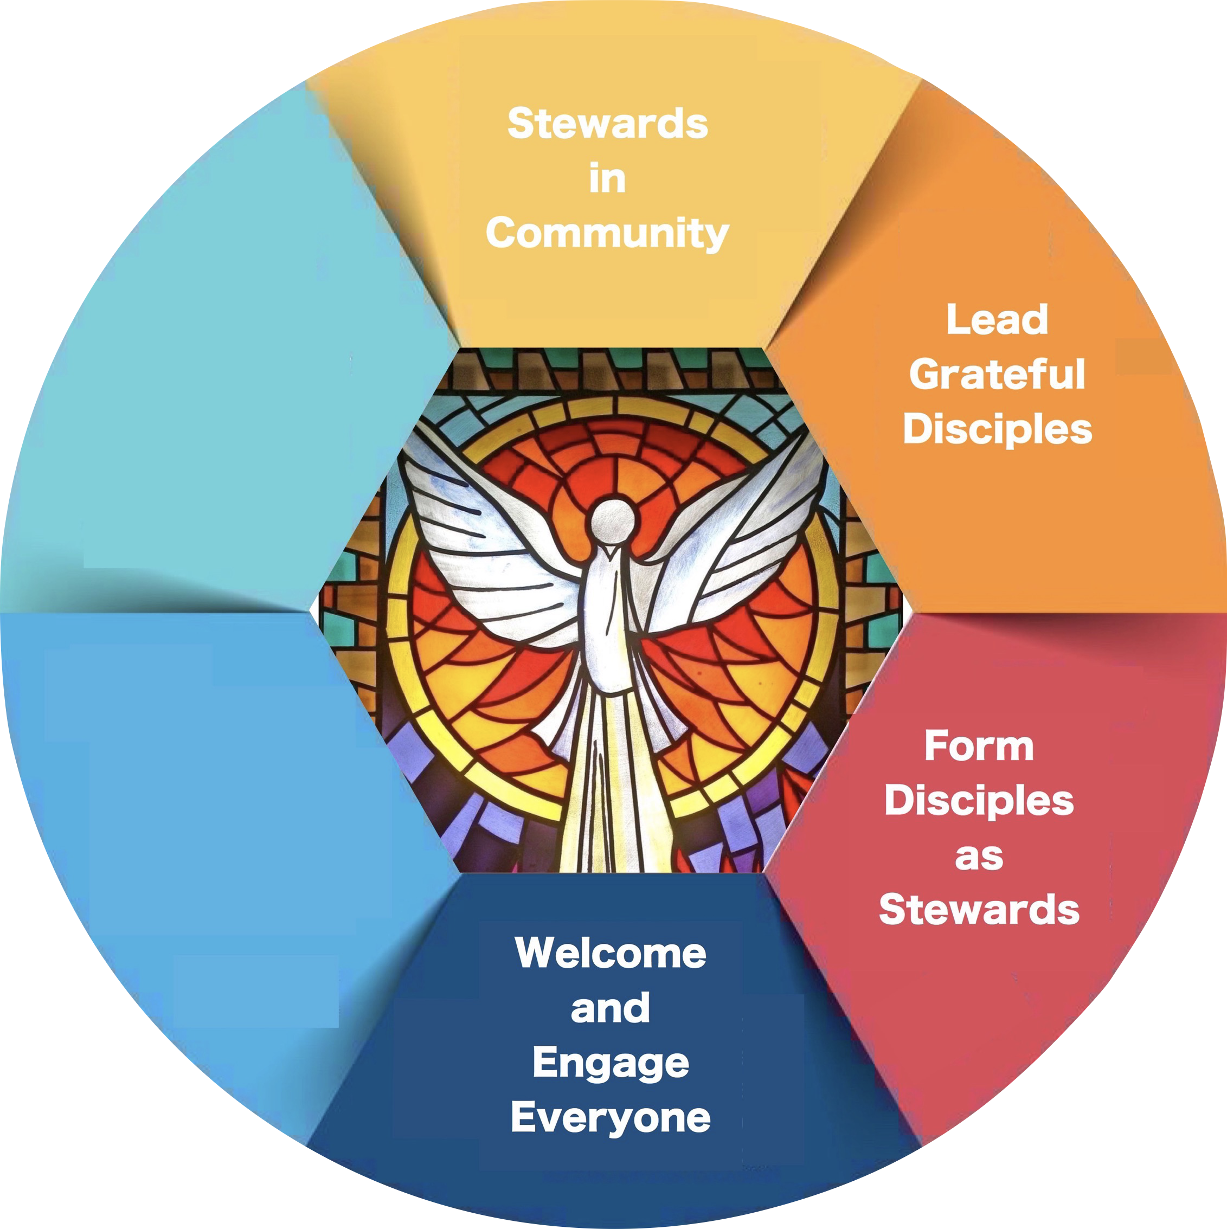
PART THREE:
Beacons of Light Connections
Welcome and Engage Everyone
Communion in community
Belonging
Evangelization
24
© Catholic Life and Faith, 2017

Slide 25
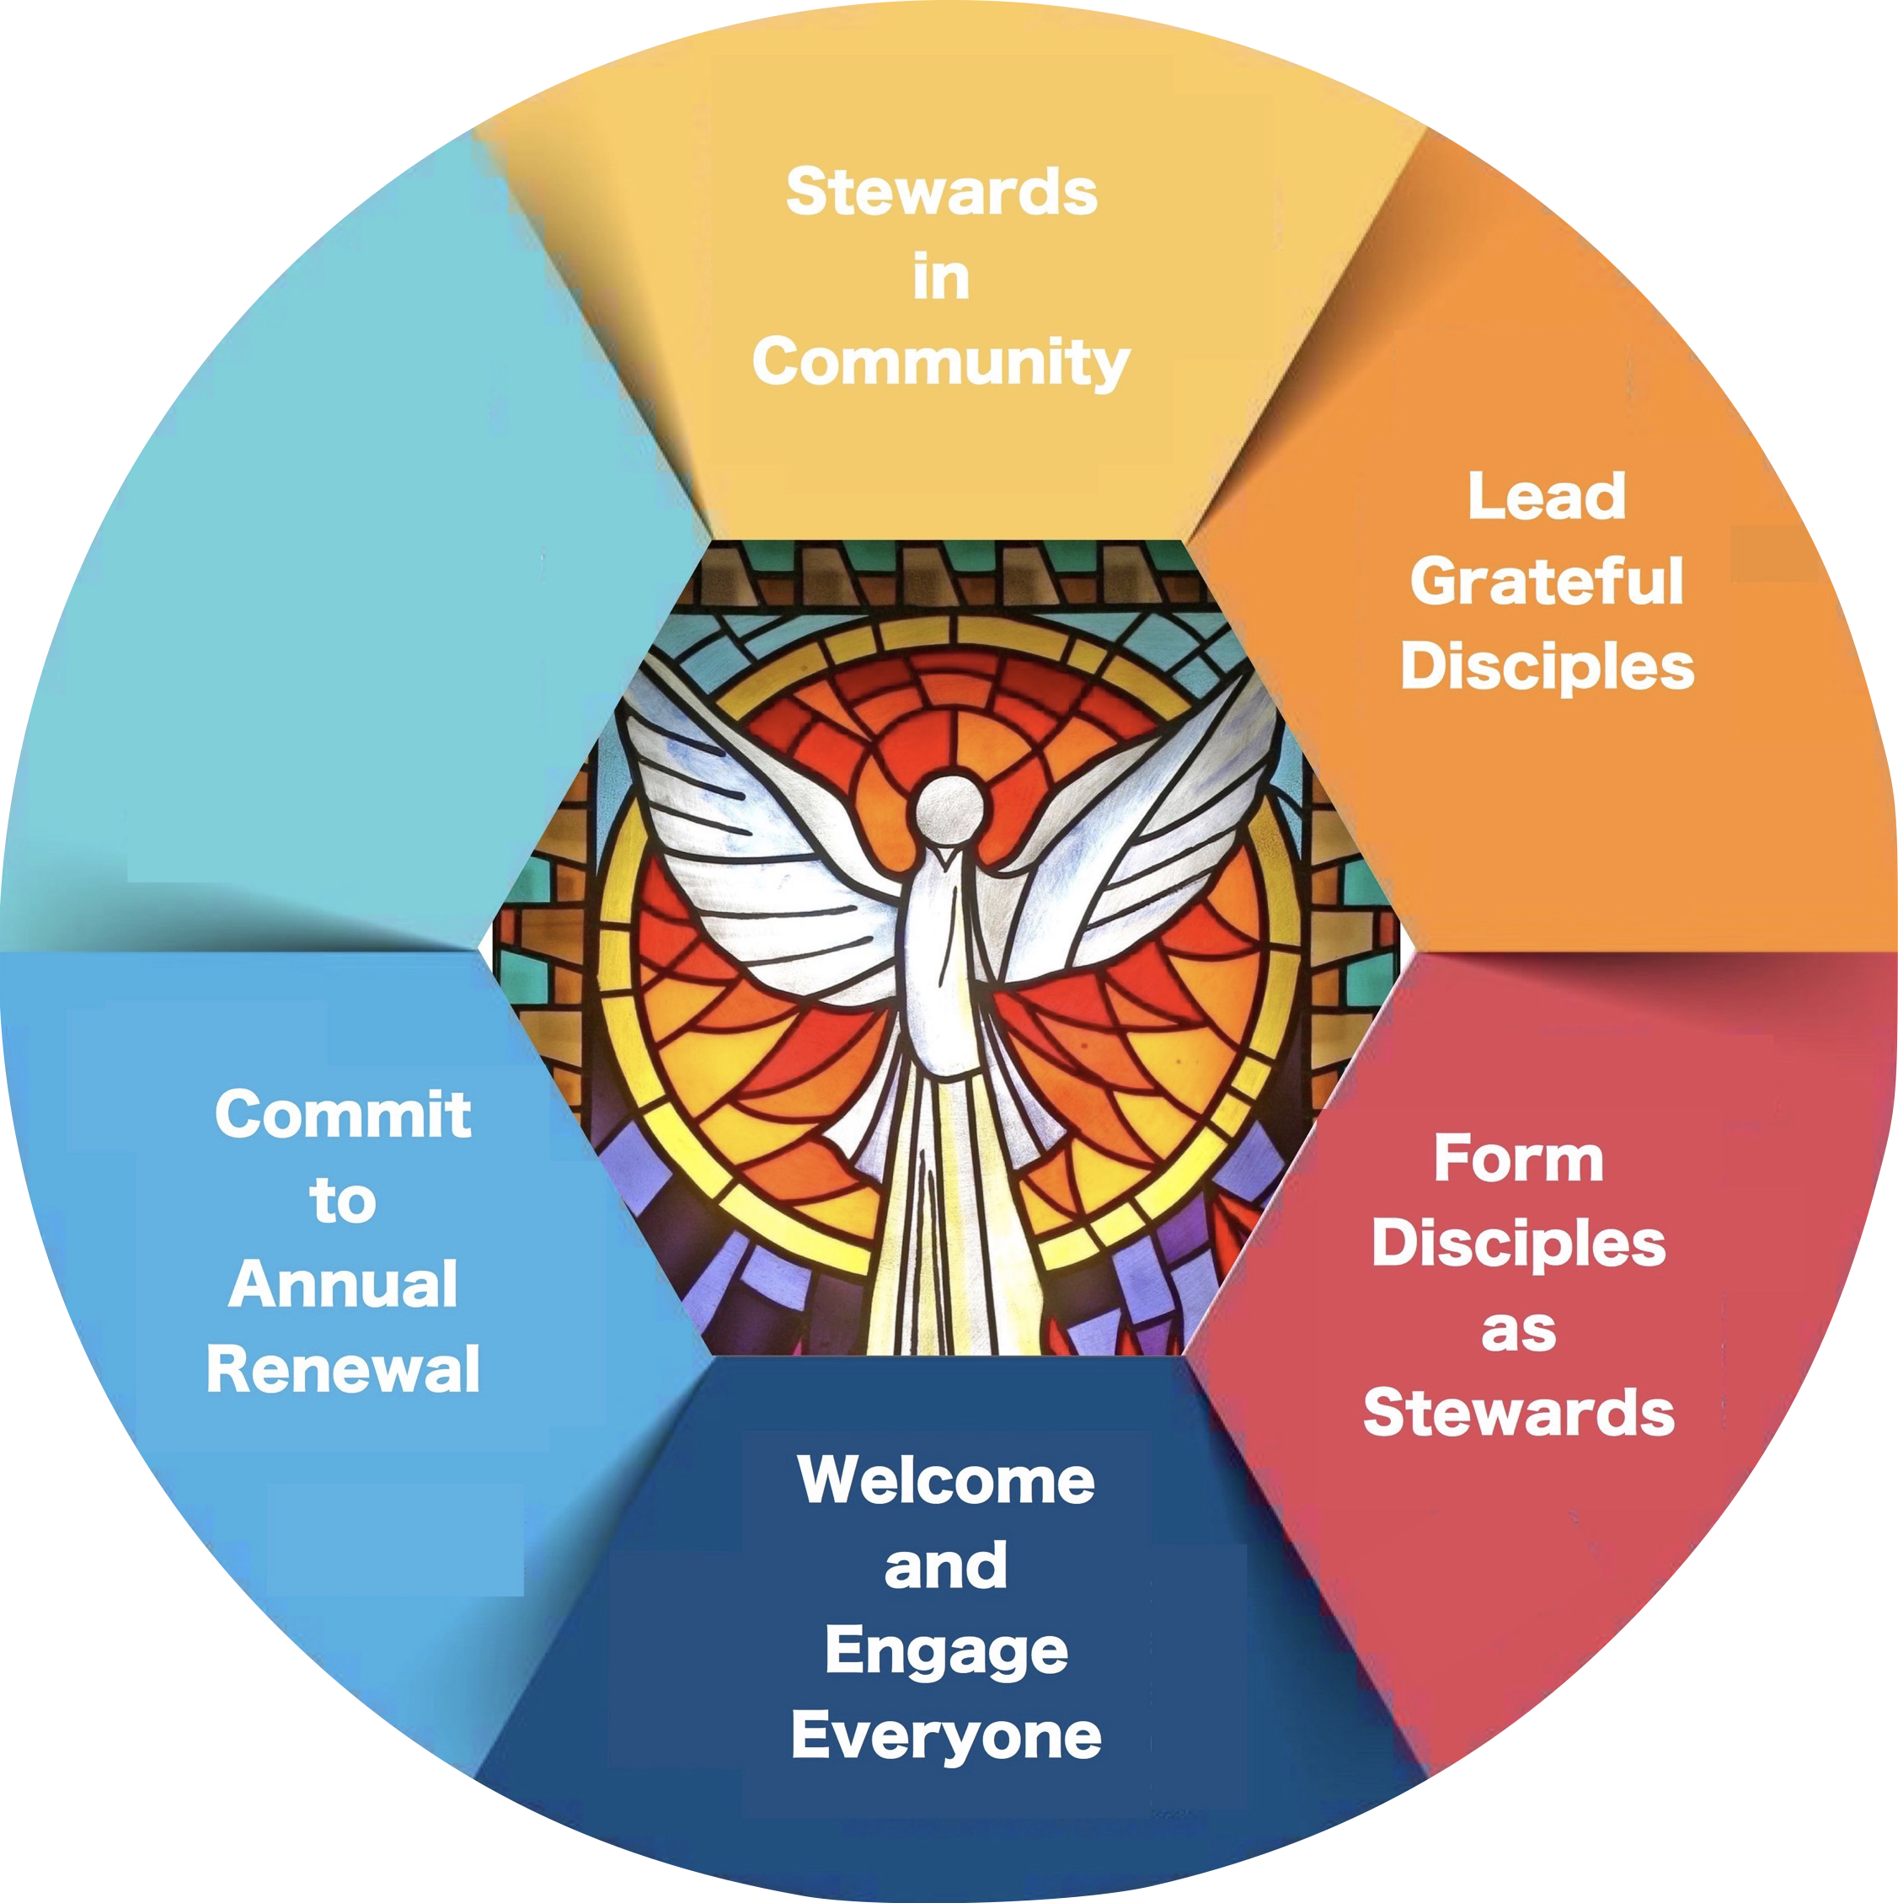
PART THREE:
Beacons of Light Connections
Commit to Annual Renewal
Members of Christ’s Body, the Church
Love in Action
Stewardship of resources
25
© Catholic Life and Faith, 2017

Slide 26
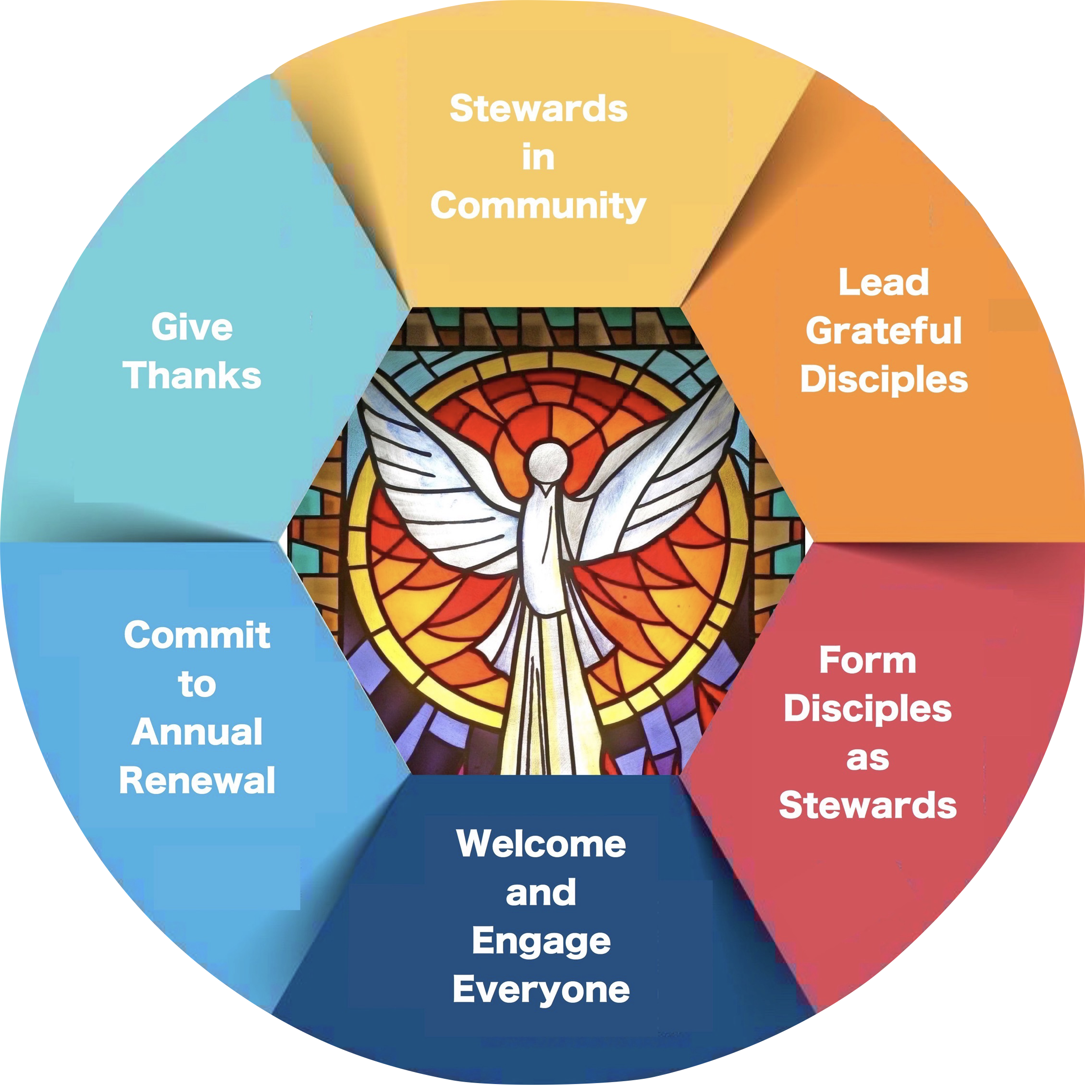
PART THREE:
Beacons of Light Connections
Give thanks. Be accountable.
Community of grateful disciples
Charity and justice
Vital parish culture
26
© Catholic Life and Faith, 2017

Slide 27
LET’S FOCUS
What comes to mind for you?
Where is stewardship most needed in your Family of Parishes?
27
© Catholic Life and Faith, 2017

Slide 28
Your thoughts?
Questions,
Wonders,
Observations
28
© Catholic Life and Faith, 2017

Slide 29
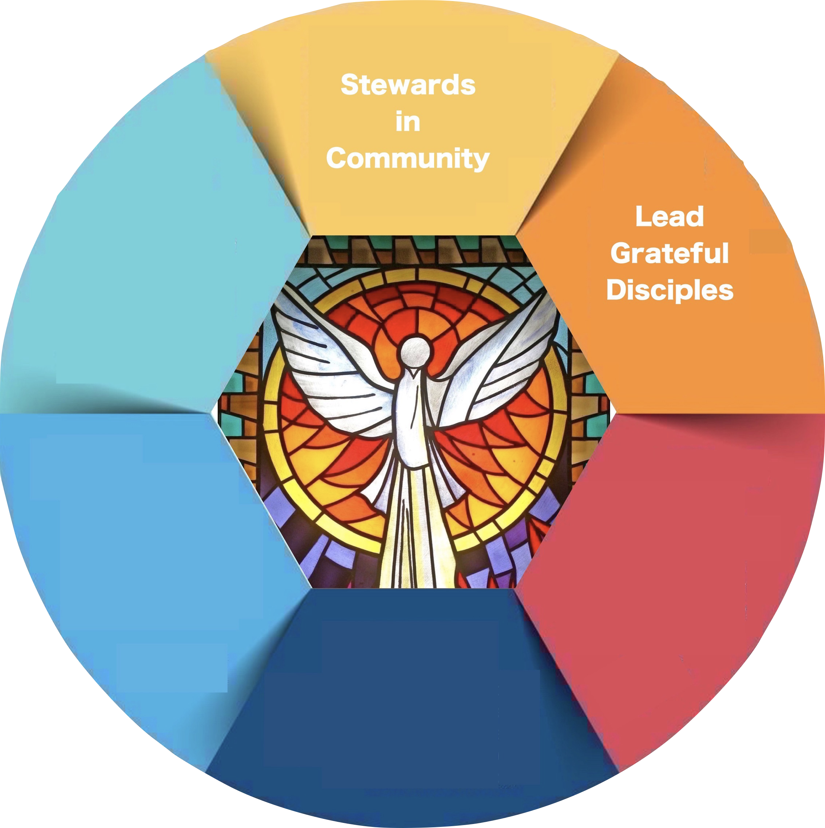
PART THREE:
Lead Grateful Disciples
29
© Catholic Life and Faith, 2017

Slide 30
Lead Grateful Disciples
“Leadership springs from within. It’s about who I am as much as what I do.” – Chris Lowney
30
© Catholic Life and Faith, 2017

Slide 31
Lead Grateful Disciples
Align people, pastoral life with the vision
Motivate and inspire
Constantly discern
31
© Catholic Life and Faith, 2017

Slide 32
Lead Grateful Disciples
The Pastor as Stewardship Leader
Witness
Teacher
Work with champion and core team
Personal invitation
Bring faith to everyday life
32
© Catholic Life and Faith, 2017

Slide 33
Lead Grateful Disciples
The Stewardship Core Team
Ongoing Formation
Spiritual and team formation
Become a strengths-based team
Learn to work from your talents and call forth the gifts of others
33
© Catholic Life and Faith, 2017

Slide 34
Lead Grateful Disciples
The Stewardship Core Team
Discern the shape of stewardship
  Establish and keep the vision of stewardship alive in people’s minds and hearts
34
© Catholic Life and Faith, 2017

Slide 35

Discern Your Core Team
Seek Core Team members who:
Are prayerful people
Willing to lead in the Family of Parishes (not only their parish)
Participate in ministry and giving
35
© Catholic Life and Faith, 2017

Slide 36
Discern Your Core Team
Can envision the positive impact of stewardship
Can become committed to this endeavor
Are ready to work as part of the team
Have some understanding of current ministries
36
© Catholic Life and Faith, 2017

Slide 37
Lead Grateful Disciples
Questions,
Wonders,
Observations
37
© Catholic Life and Faith, 2017

Slide 38
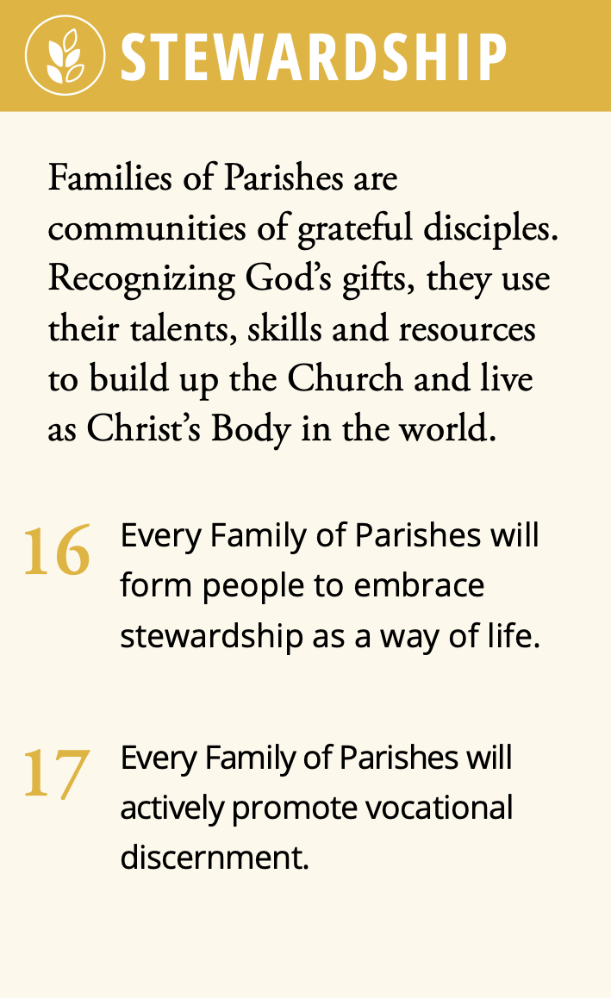
Bring the Stewardship Principle to Life
Fall cohorts of core teams
Resources on Pathway Platform
Impact
Master worksheet copies/samples
38
© Catholic Life and Faith, 2017

Slide 39
An Initial Exercise
39
© Catholic Life and Faith, 2017

Slide 40
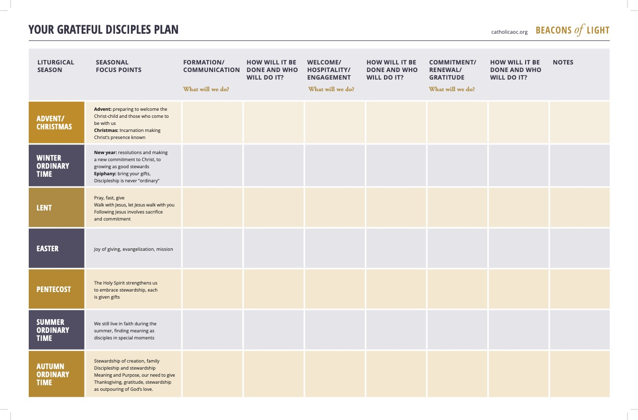

Slide 41
Your Next Steps
If you are:
A pastor
A champion
A staff person or parishioner leader
41
© Catholic Life and Faith, 2017

Slide 42
Your Next Steps
Email coming soon!
Links
Contact info
Be on the lookout for upcoming dates
42
© Catholic Life and Faith, 2017

